Slide 1
DDD, EF, WebAPI

Slide 2

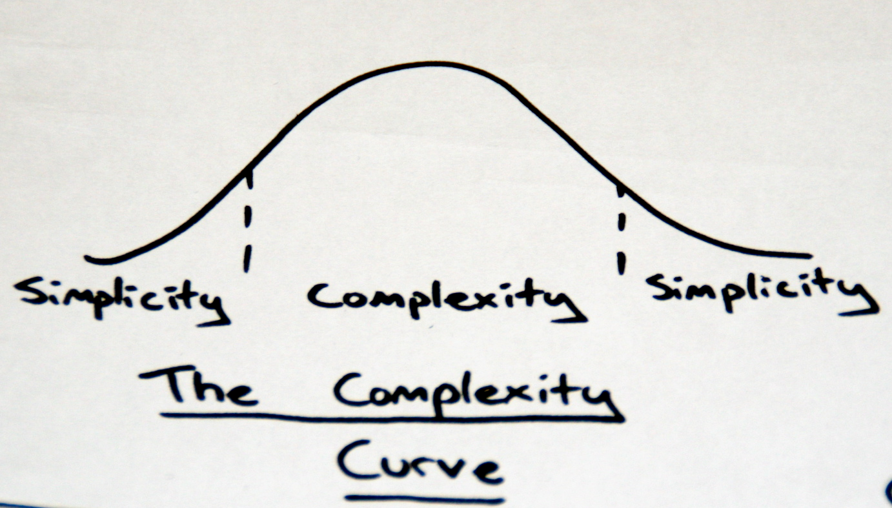
EF & DDD

Slide 3
DDD
Koncepti
Patterns
Ubiquitous Language
Bounded Contexts
Persistance ignorance
Refactoring
CQS / CQRS
Kada upotrijebiti DDD?
Entities
Value objects
Aggregate roots
Repository
Domain Services
Domain Events
State

Slide 4

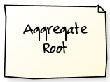







*
Aggregate root

Slide 5
3-SLOJNA ARHITEKTURA
Presentation
Business Logic (BLL)
Infrastructure
Data Access (DAL)

Slide 6
ONION ARHITEKTURA
EmployeeController
IEmailSender
User Interface
G
Application Services
M
Database
Domain Services
IOrderProcessor
Services
Domain Model
File
system
Employee,
IEmployeeRepository
Tests
Infrastructure
etc
SmtpEmailSender
NHibernateEmployeeRepository

Slide 7
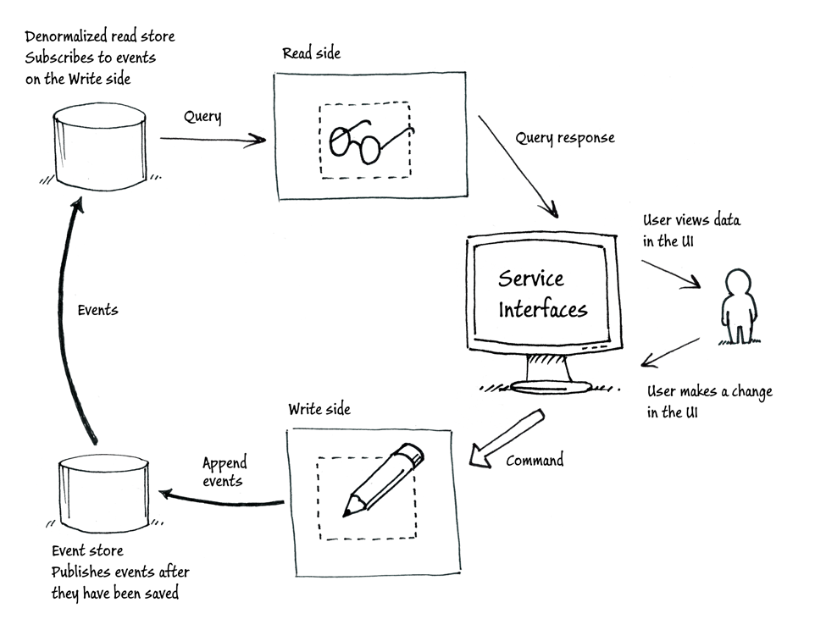

Slide 8
EF + DDD
Unit of Work
Privatni konstruktori
Privatni set-eri
Value objects vs Entities
Kompleksni tipovi
Repozitoriji vs. CQS

Slide 9
EF 6.1 NOVOSTI
DbContext
Enums, spatial
Code first
Migrations
Mappings, conventions
Multiple diagrams per model
Async, perf improvements, Connection Resiliency
Interceptors, custom configuratiomn, DI
Open sourced, out of .NET Fx
Nuget package + VS Tools addon download

Slide 10
„Any fool can write code that a computer can understand. Good programmers write code that humans can understand.”
Martin Fowler

Slide 11
WEBAPI
Zašto trebamo REST?

Slide 12
REST
Athitektura bazirana na HTTP protokolu i web principima
Vezana iskljucivo za HTTP
Lightweight
Stateless
Caching “out of the box”
Jednostavna konzumacija (mobile, JS)
Cilj: skaliranje, odvojenost komponenti, funkcionalnost izvan granica servisa

Slide 13
REST
CLIENT
GET /api/tickets/3
TICKETS
200 OK { title:”ticket name”,...}
POST /api/user { name:””, ...}
USERS
201 CREATED Location: /api/users/42

Slide 14
WebAPI
URL Routing
Convention routes
Attribute based routes
Content negotiation
IContentNegotiator
Accept: application/json, application/xml; q=0.9, */*; q=0.
Formats (JSON, XML, ATOM)
MediaTypeFormatter
Accept: text/html,application/xhtml+xml,application/xml
Self-hostable (OWIN based), testable, extensible

Slide 15
API CONTROLLER, ATTRIBUTE ROUTING
public class ProductsController : ApiController { public IEnumerable<Product> GetProducts() {...} public Product GetProductById(int id) {...} public HttpResponseMessage PostProduct(Product product) {...} }
[RoutePrefix("api/agents/{agentId}")]
public class ObservationsController : ApiController
{
// GET api/agents/bond/observations
[HttpGet("observations/{date}")]
public Observation Get(string agentId, DateTime date) { ... }
}

Slide 16
VALIDATION
public class Contact {
[Required]
public string FullName { get; set;}
[Email]
public string Email { get; set;}
}
if (!this.ModelState.IsValid) {
var errors = this.ModelState.Where(s => s.Value.Errors.Count > 0)
.Select(s => new KeyValuePair<string, string>
(s.Key, s.Value.Errors.First().ErrorMessage));
response = Request.CreateResponse(
HttpStatusCode.BadRequest, errors);
}

Slide 17
ODATA
The Open Data Protocol (OData) provides a RESTful standard for exposing data models
OData uses URIs to perform query operations:
Entity projection – $select, $expand
Sorting – $orderby
Entity sub-setting – $top, $skip
Filtering – $filter, logical operators: eq, ne, gt, lt
Install the Microsoft.AspNet.WebApi.OData NuGet package
Define an action with the following characteristics:
Returns IQueryable<T> or IEnumerable<T>
Decorated with the [Queryable] attribute

Slide 18
ODATA
[Queryable] public IQueryable<Agent> GetAgents() { return repository.GetAll().AsQueryable(); }
api/agents?$orderby=Name
api/agents?$skip=10
api/agents?$skip=50&$top=10
api/agents?$filter=salary gt 50000

